Slide 2
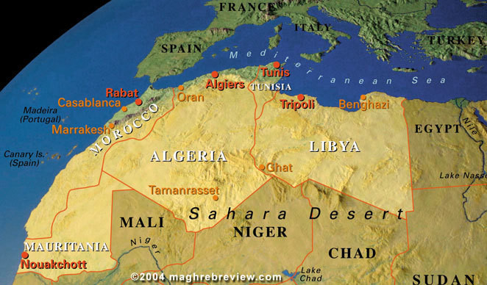

Slide 3
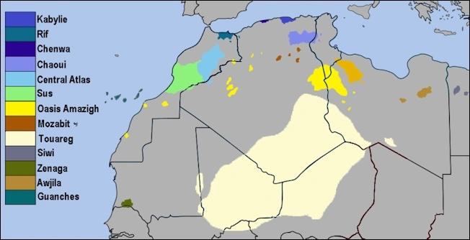

Slide 4
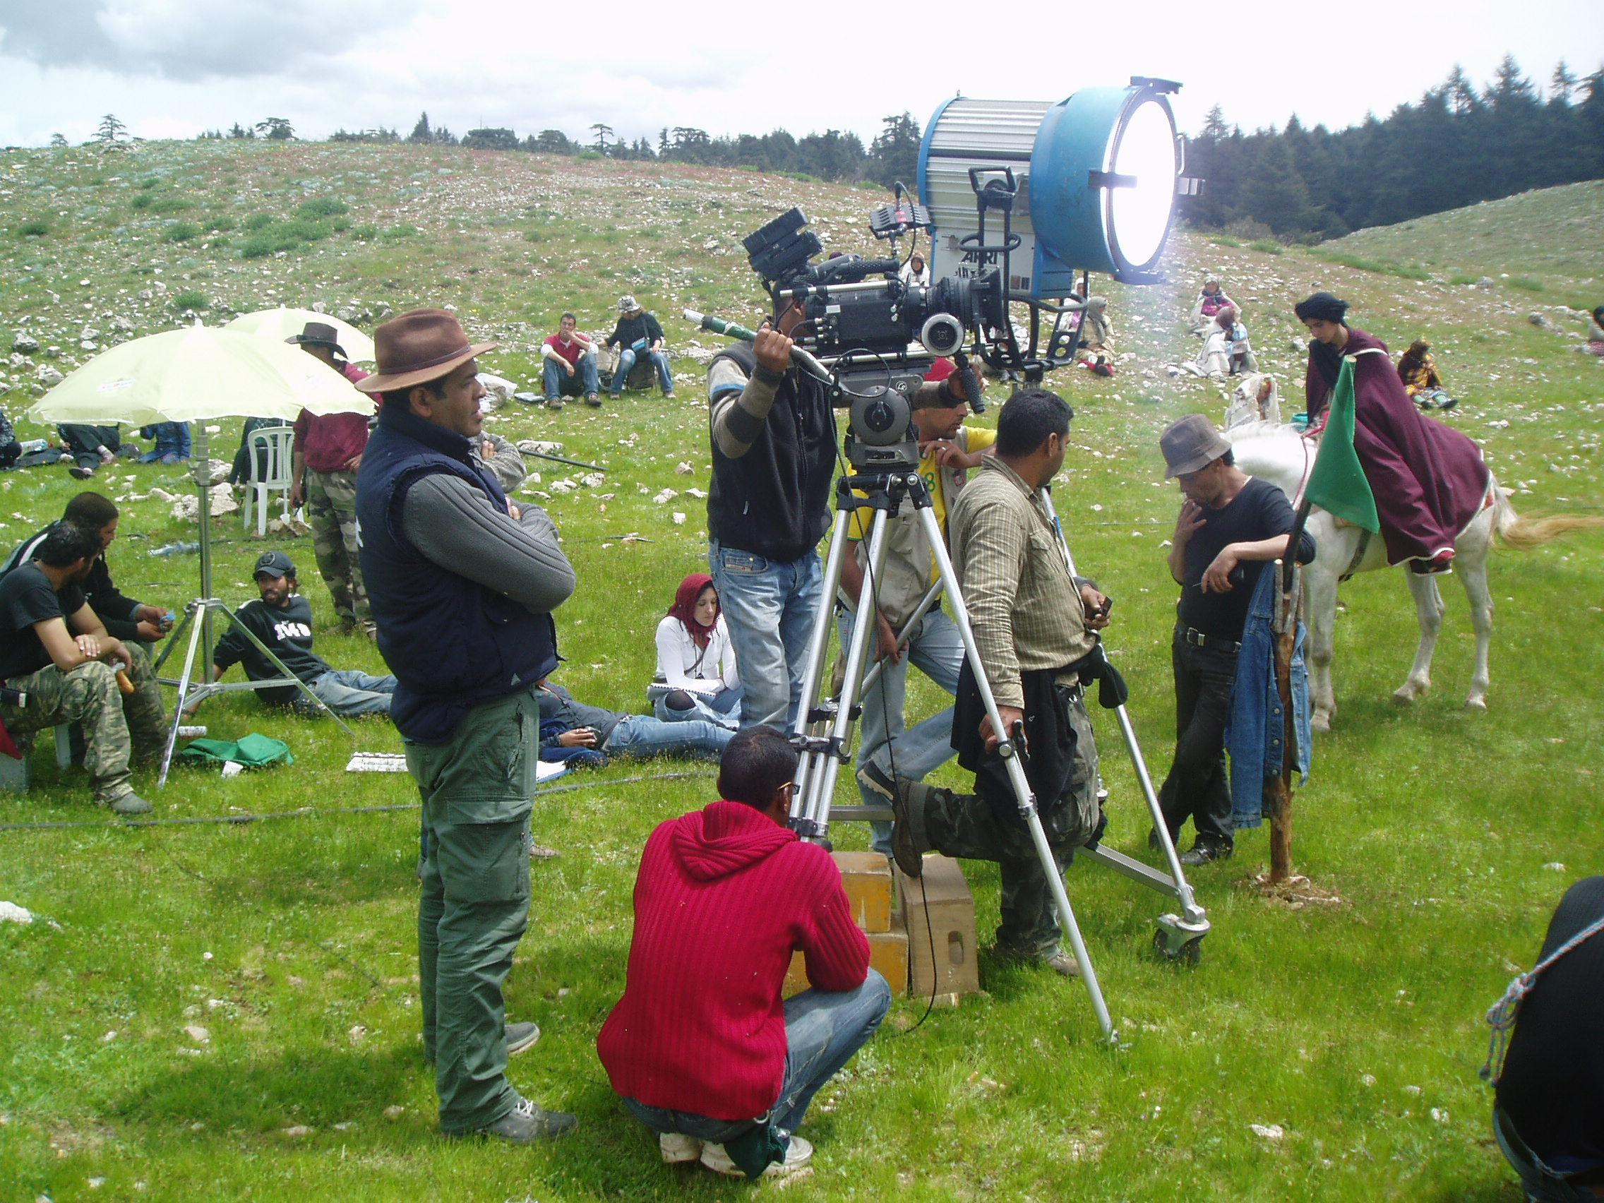
Alaoui Lamharzi Azlarabe
Moroccan filmmaker
Androman
(Blood and Coal)
Fiction, 2012

Slide 5
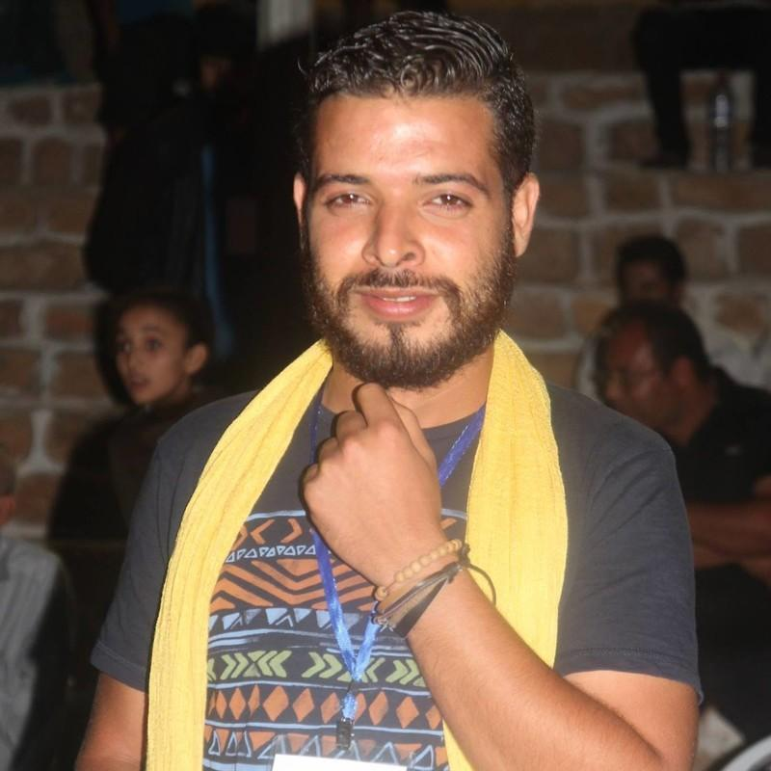
Chahine Berrich
Tunisian Filmmaker
Tamorithiw Azrou
Documentary, 2022

